Slide 1
s.m. - dropdown
Cantitate s.m./doza - input
Profil de cedare:
Cedat la 5 min - input
Cedat la 10 min - input
Cedat la 20 min - input
Cedat la 30 min - input
Formulare
% s.m.
% PVA
% plastifiant (manitol)
Parametrii proces FDM
Temparatura duza extrudare
Temperatura masa imprimare
Viteza imprimare
Procent infil
Design/marime imprimat
Parametrii proces HME
Temperatura extrudare
viteaza suruburi
Salveaza - buton

Slide 2
Medical prescription:
Prediction:
Active substance
- Please select from dropdown list -
drug strength/unite dose
- Please fill the input value -
Formulation (qualitative and quantitative formula)
Active substance %
Polyvinyl alcohol %
Manitol (plasticizer) %
Desired drug release profile:
% of drug release in 5 min
- Please fill the input value -
% of drug release in 10 min
- Please fill the input value -
% of drug release in 20 min
- Please fill the input value -
Prediction for HME step:
% of drug release in 30 min
- Please fill the input value -
HME - processing parameters
Extrusion temperature
Screw speed
Calculate
the predicted values
HME – filament processability
Printability score
Prediction for FDM step :
FDM processing parameters
Nozel temperature
Plate temperature
Printing speed
Printlet weight
Printlet size
Save
the predicted values

Slide 3
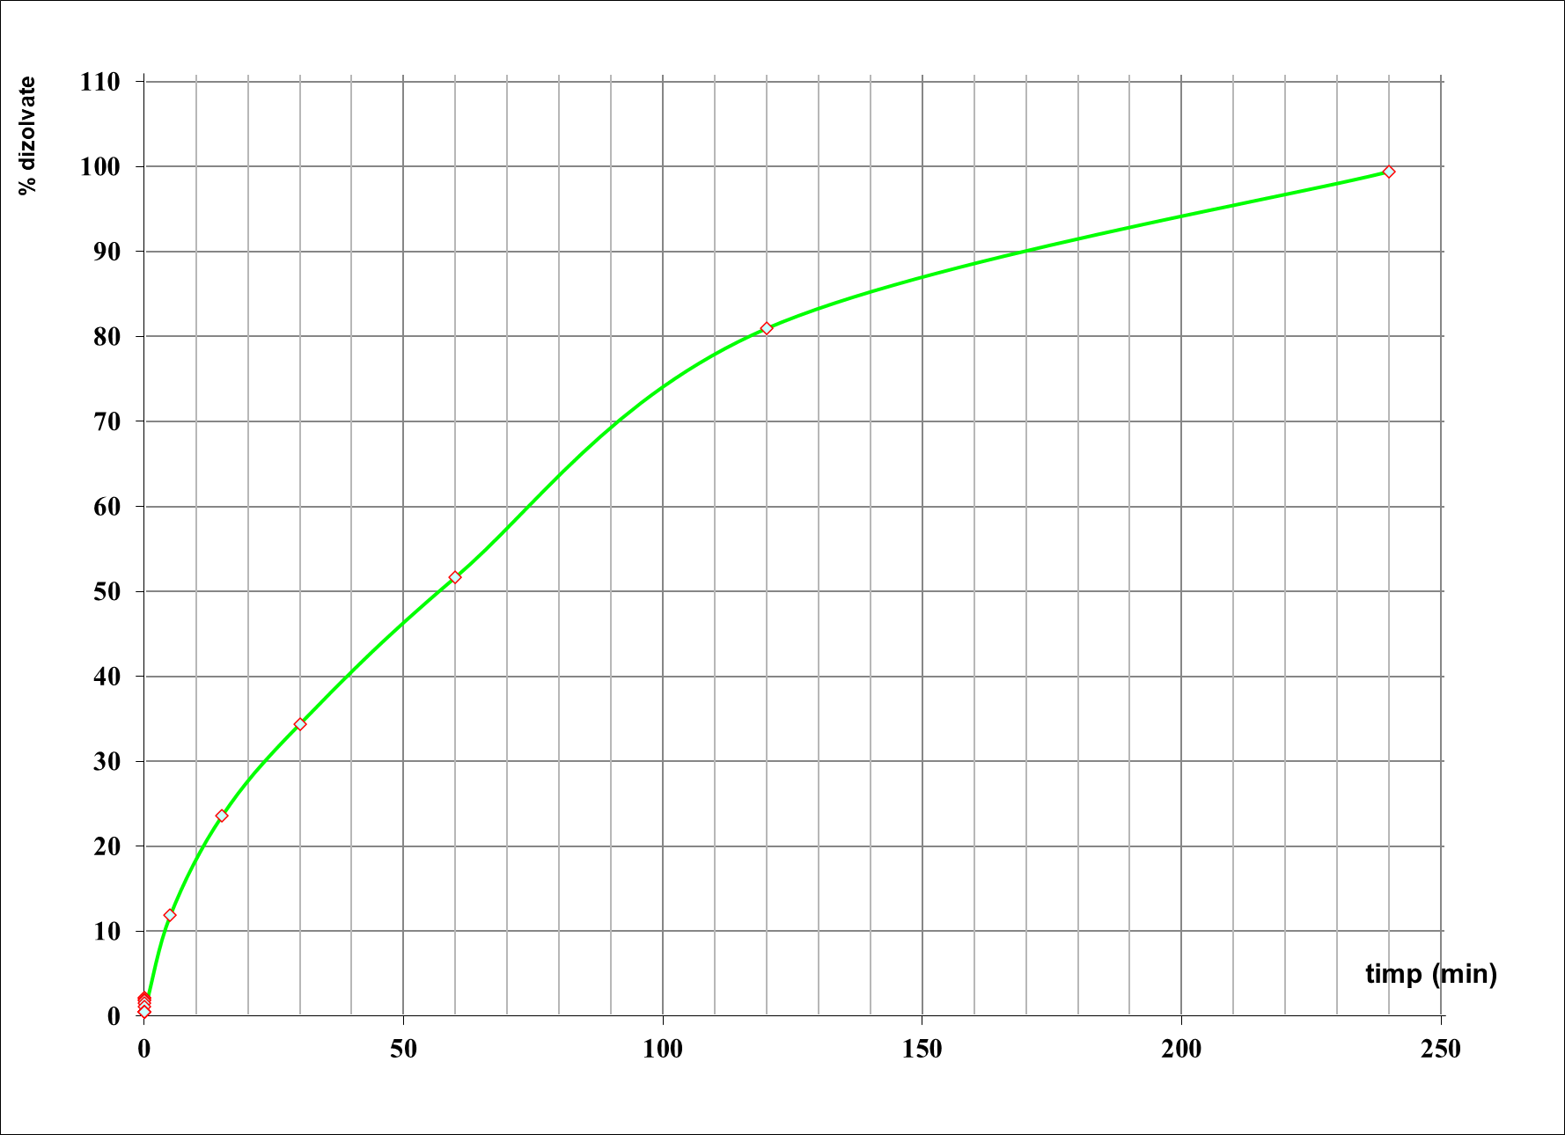
Medical prescription:
Prediction:
Active substance
- Please select from dropdown list -
drug strength/unite dose
- Please fill the input value -
Formulation (qualitative and quantitative formula)
Active substance %
Polyvinyl alcohol %
Manitol (plasticizer) %
Desired drug release profile:
% of drug release in 5 min
- Please fill the input value -
% of drug release in 10 min
- Please fill the input value -
% of drug release in 15 min
- Please fill the input value -
% of drug release in 30 min
- Please fill the input value -
Prediction for HME step:
HME - processing parameters
Extrusion temperature
Screw speed
% of drug release in 30 min
- Please fill the input value -
% of drug release in 60 min
- Please fill the input value -
HME – filament processability
Printability score
% of drug release in 120 min
- Please fill the input value -
% of drug release in 180 min
- Please fill the input value -
% of drug release in 240 min
- Please fill the input value -
Prediction for FDM step :
% of drug release in 300 min
- Please fill the input value -
FDM processing parameters
Nozel temperature
Plate temperature
Printing speed
Printlet weight
Printlet size
Calculate
the predicted values
Save
the predicted values

